Slide 1
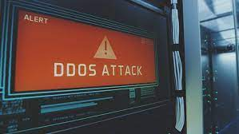
How I dealt with a DDoS attack that killed a Game Server
Pranay Meshram
Your local neighbourhood NSQ host

Slide 2
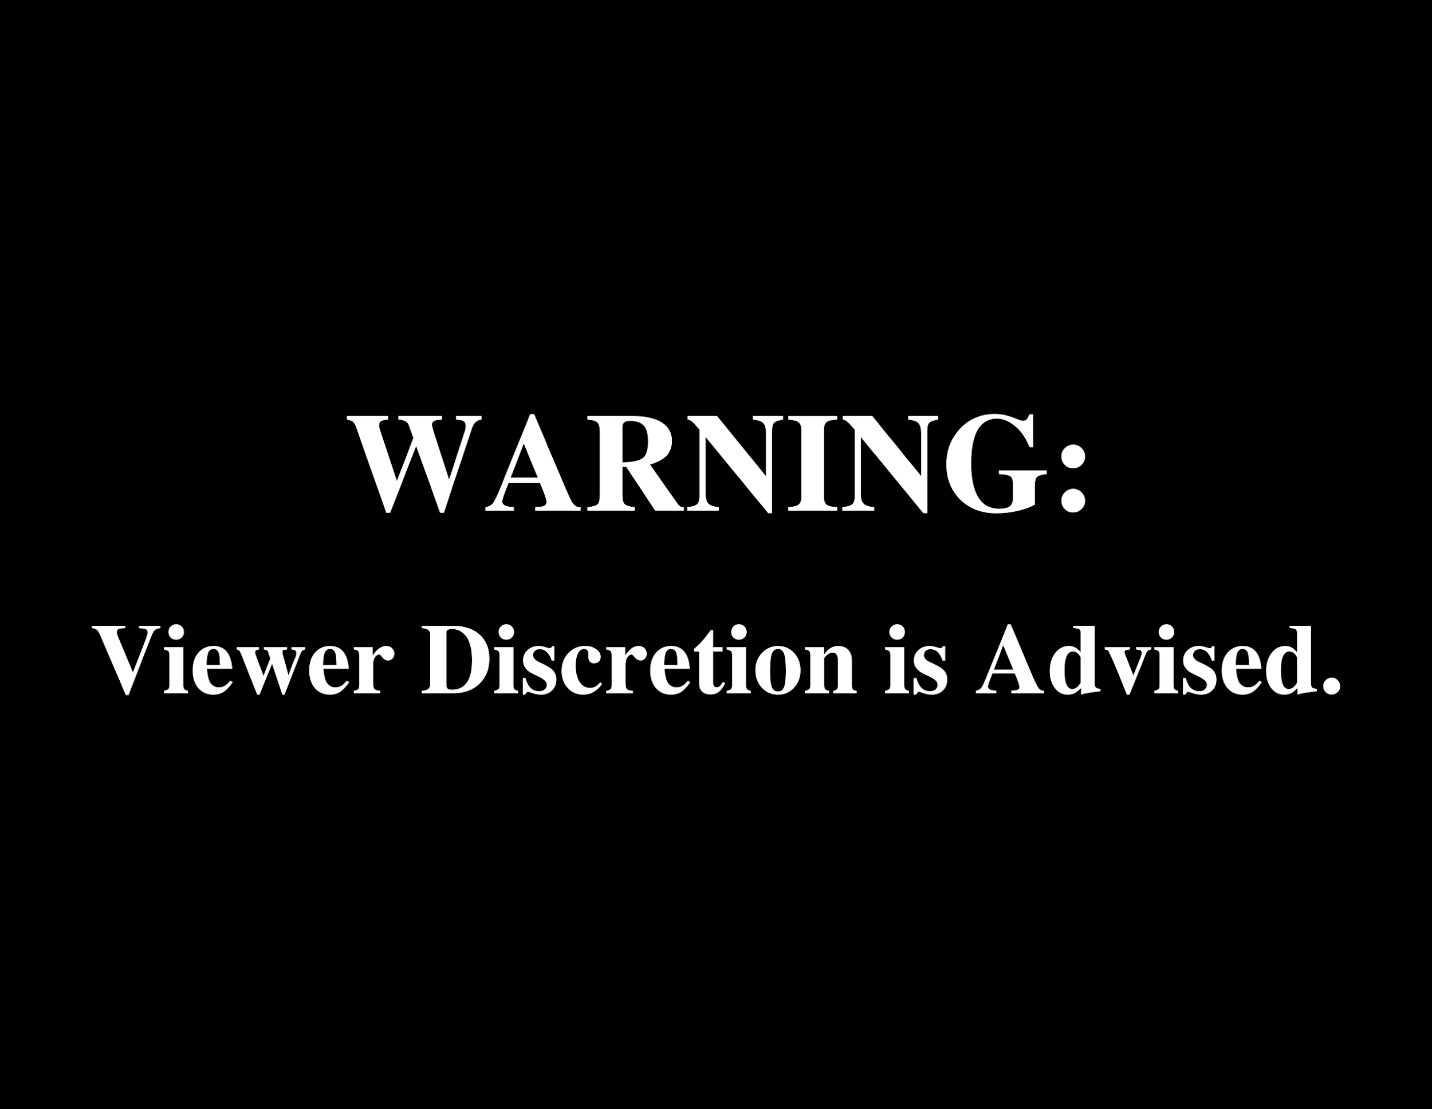
Some information presented may be incomplete.
Please don’t be harsh with questions!

Slide 3
Introduction to Service Attacks

Slide 4
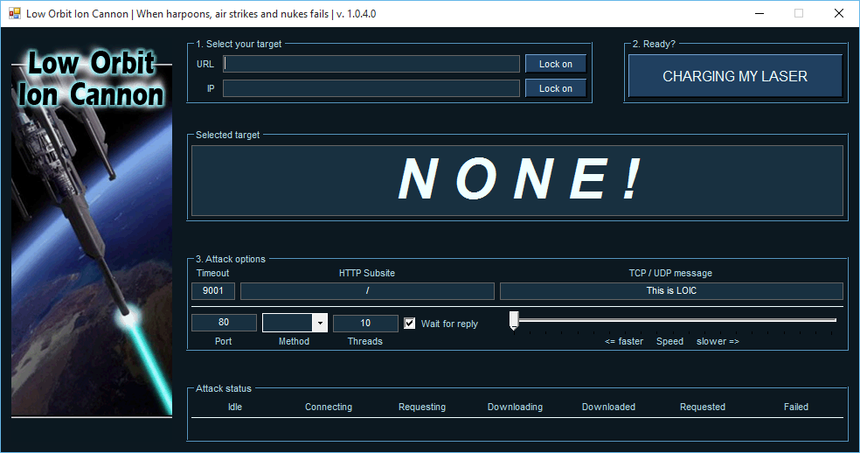
A service attack is a type of cyber attack that aims to disrupt or disable the normal functioning of a computer system or network.
It works by overwhelming it with traffic or requests.
The goal of a service attack is to prevent legitimate users from accessing the system or service.
Two major types: DDoS - Distributed Denial of Service DOS - Denial of Service
Famous Example - Mirai botnet.
Attacked OVH with 1.1 Tbps per second of traffic or 17.2 million requests per second.
Costed $40-120k per hour
Connected to 600k devices.
Notes:
Talk about how Mirai botnet had more than 600k IOT things - phones, cameras and etc used as bots. Attacked OVH with a traffic of 1.1 Terabits per second. Talk about how DOS attacks cost 12-13k per hour.

Slide 5
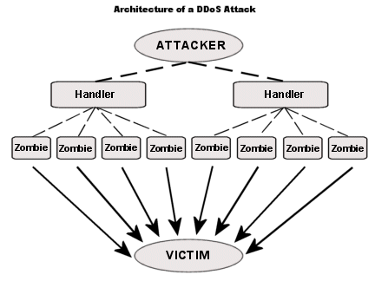
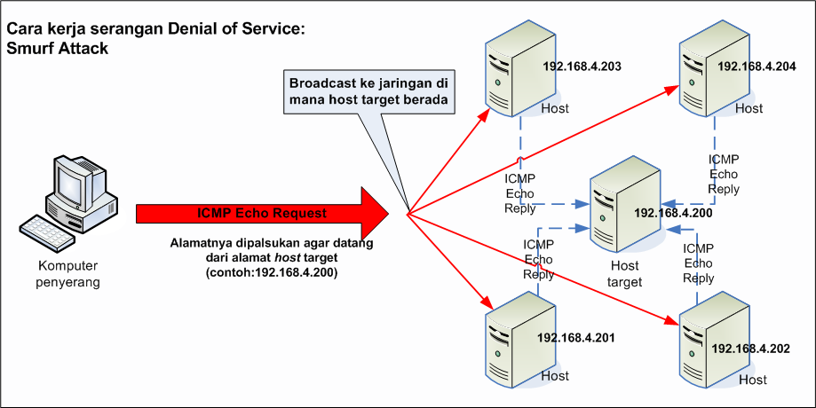
DDoS vs DOS
Distributed Denial of Service (DDoS) | Denial of Service (DoS)
Multiple systems target a single system with a DoS attack. The targeted network is then bombarded with packets from multiple locations. | A single computer is used to flood a server with TCP and UDP packets
Harder to detect | Easier to detect
Use botnets or multiple devices | Use a single script or tool
Examples: 1) Buffer overflow 2) SYN attack | Black Friday Sales ICMP Flood
Notes:
DDOS - multiple, DOS - single. ICMP flood also called as ping of death Botnets - Also called as zombies We will be focusing on Distributed Denial of Service

Slide 6
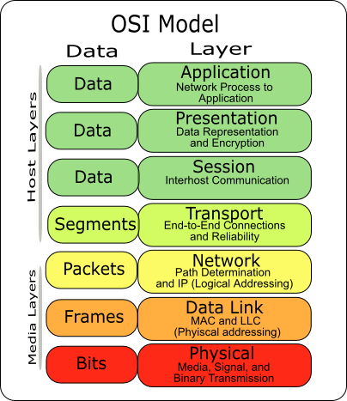
Layers of DDoS Attacks
Layer 7 is usually the most common with HTTP/GET requests. Hard to detect as they deal with applications, easily eat up resources.
DNS amplification attacks happen at Layer 3.
SYN, TCP, UDP attacks happen at Layer 4.
Website DDoS - Web Services - Layer 7
Application DDoS - Layer 4 - Gaming, VOIP, etc.
Network DDoS - Layer 3 - for on-premise, cloud, & hybrid networks. Combine DDoS protection, traffic acceleration, & more.

Slide 7
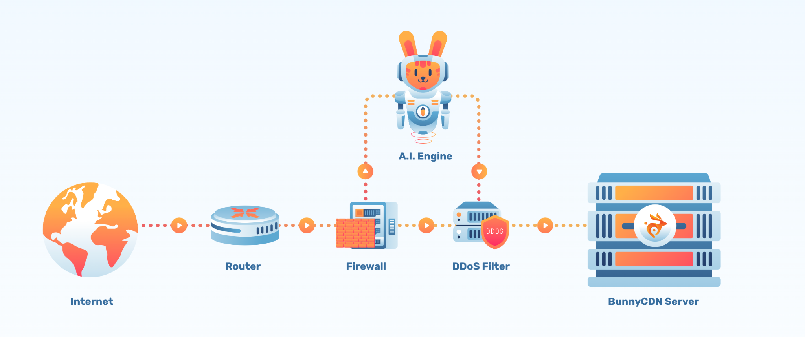
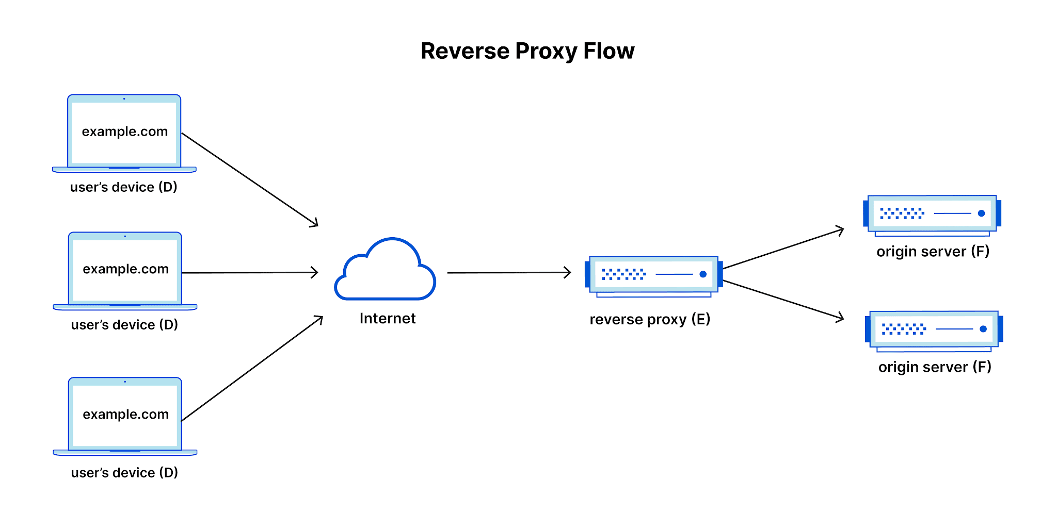
DDoS Mitigation!!
Different providers provide DDoS Mitigation methods eg Cloudflare, Akamai, OVH.
Common methods: - Using AI to survey traffic and deploy firewall. - Using reverse proxy to redirect data to different server with higher bandwidth, than to intended server. - Blocking access to ALL traffic - Pray no one messes up with you
Notes:
Expand on 3rd on how it blocks access to all valid and suspicious traffic, a common activity ISPs do as part of typical Layer 4 DDoS mitigation.

Slide 8
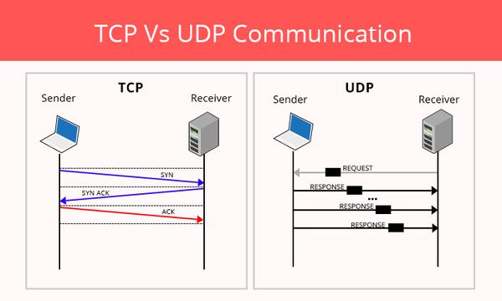
TCP vs UDP
TCP | UDP
Connection Oriented | Message Oriented
Delivery of message is verified | No verification of delivered message
Ensures message is delivered | Possibility that your data will be lost
Slower | Faster
Notes:
TCP - focus on sending accurate data, UDP - focus on sending data - suited for comms & broadcast systems TCP - has three way handshake as visible with SYN and ACK UDP - faster because does not assure delivery of packets TCP - used for email or downloading/viewing web page. UDP - Broadcasting

Slide 9

Introduction to the real problem

Slide 10
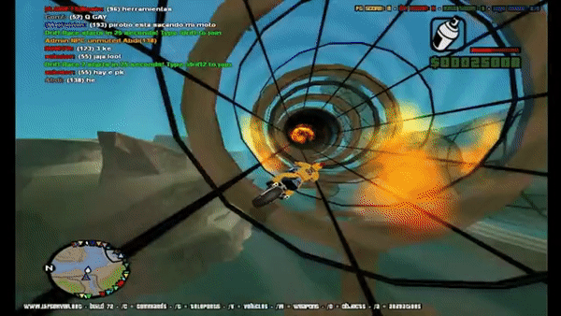
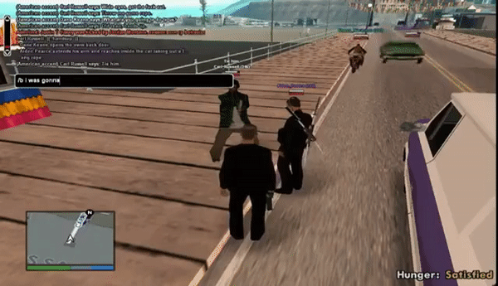
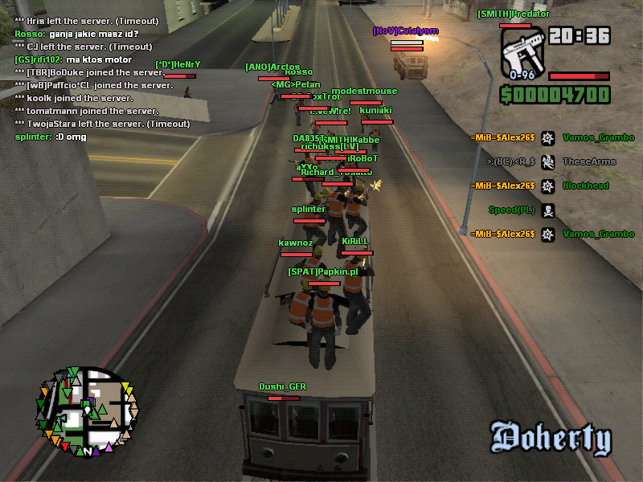
SAMP (San Andreas Multiplayer)
Massive multiplayer mod for GTA San Andreas.
Allowed seamless multiplayer up to 1500 real-time players in one server.
Entire mod had several servers, and on average the mod had 90k-100k players.
Developed by one person, maintained by a close team.
Variety of gamemodes.

Slide 11
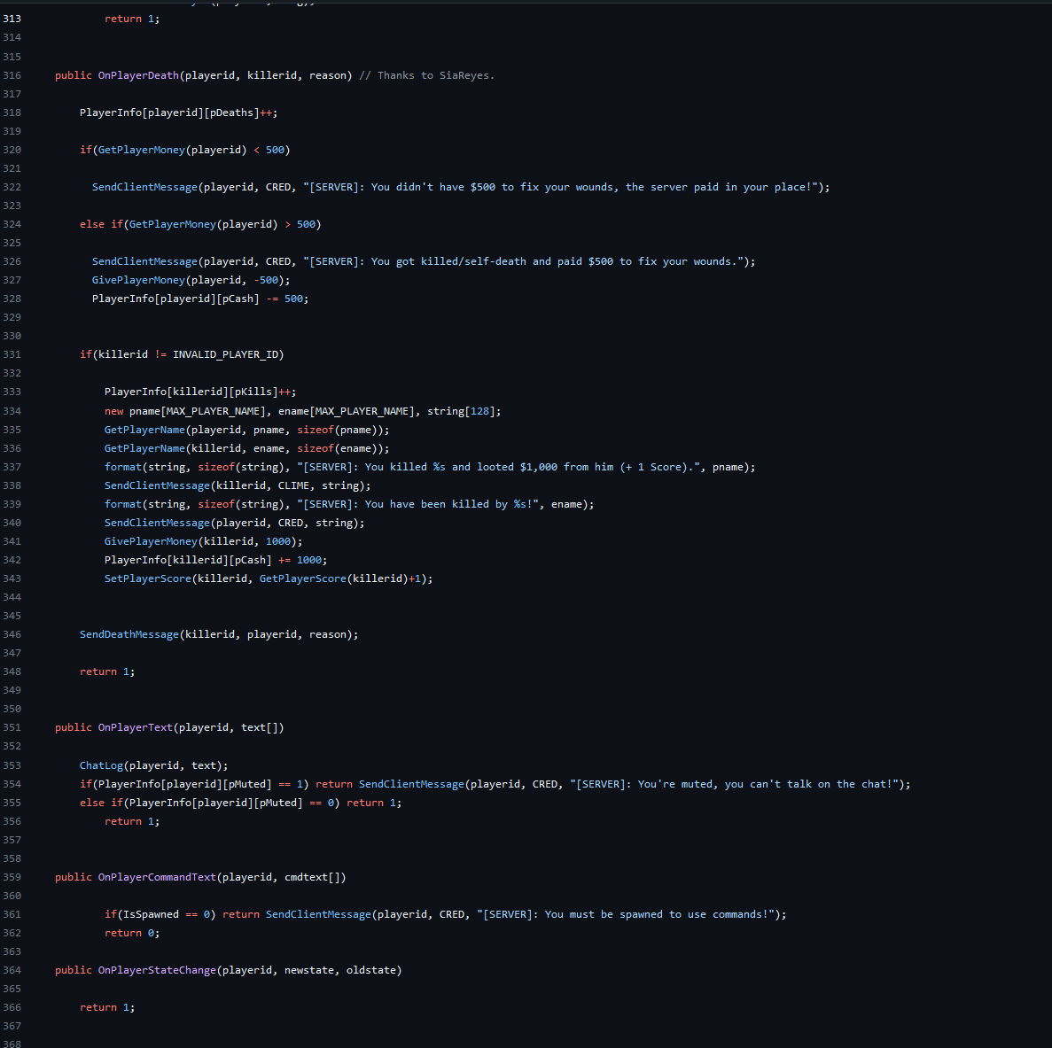
Notes:
Scripting language was PAWN, having a syntax similar to C# This was a simple server Actual server coding files exceeded 100,000 lines of code

Slide 12
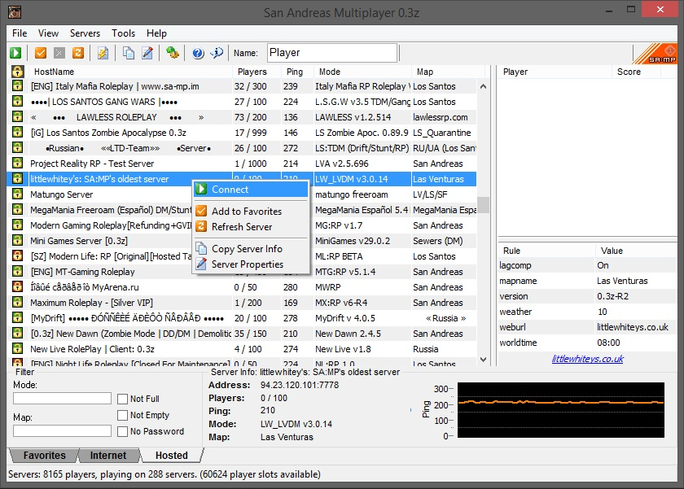

Can you guess which protocol SAMP uses? UDP or TCP?
UDP
Why?
In multiplayer games like SAMP, low-latency is critical. UDP ensures low-latency, high speed TCP first ensures data is delivered which takes time
Notes:
State of game will change by the time we get the packet back, not ideal for MP games.Especially when real-time movement and positions every milli-second is crucial.

Slide 13
Problem starts now..
Pre-Start of Incident
User “SankeyKing” breaks server rules.
User punished for breaking rules.
User threatened to ‘bring down the server’. Nobody believed, and user was punished.
Start of Incident
Minutes after, server chat starts lagging. Users being to time-out.
Server brought down, users unable to connect.
Happened multiple times as days went by.
Some lil detective work
User tricked to connect to TeamSpeak3, tracked IP to lead location to Pakistan.
User revealed his FaceBook ID as well, only 16/17 year old.
DDoS was of high magnitude, expensive.
Notes:
Emphasis on how it was hard to get his IP IG because he used VPN. And a 16/17 year old kid brought down the entire server.

Slide 14
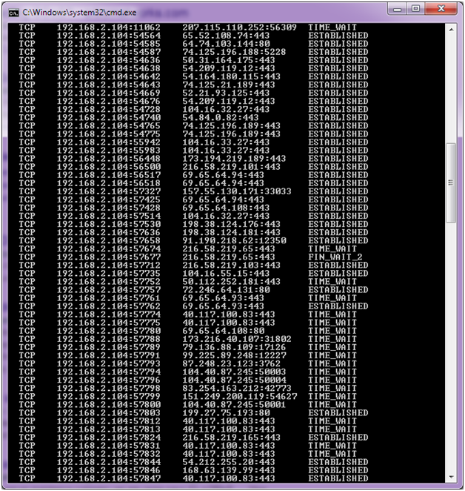
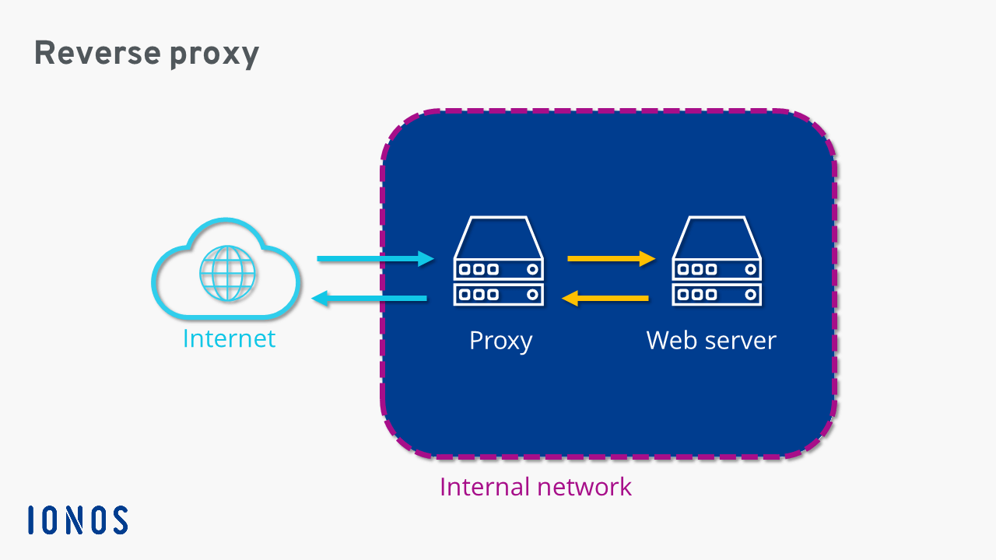
Mitigating the attack
CHANGE VPS
REVERSE PROXY
Tried changing from Cheap VPS to OVH.
Helped with nothing.
Costs issue.
1) Have two servers with same DNS name. 2) Have a new server with high bandwidth taking the traffic, route it to main server.
Manual DDoS protection
RANGE BAN
1) This protection would be manually enabled/disabled. 2) When enabled, it would filter all the incoming traffic. Verify, and then accept connection. 3) Trust issues, connection issues
Tried to ban all IPs from hacker’s region.
All bots IPs were from around the world.
No help with the issue.
Notes:
OVH had dedicated DDoS protection, but it was low tier. We were low on costs and could not afford a proper VPS with dedicated DDoS protection.
Basically to try handle less traffic for main server.
This was a new DDoS provider where you had to go to the site to enable protection. Minus sides - you had to wait for DDoS to happen, user-access was issue as you had to trust people with credentials so they can enable it manually. And since the protection verified IP addresses first, the connection to the server was super slow. Players took a long time joining and got irritated.
Early on thought to try ban all IPs from Pakistan to disallow all connections. Bots in DDoS were from around the world so it helped nothing. Explain how if it was a DOS attack, this would have helped mitigate but because of DDOS multiple connections

Slide 15
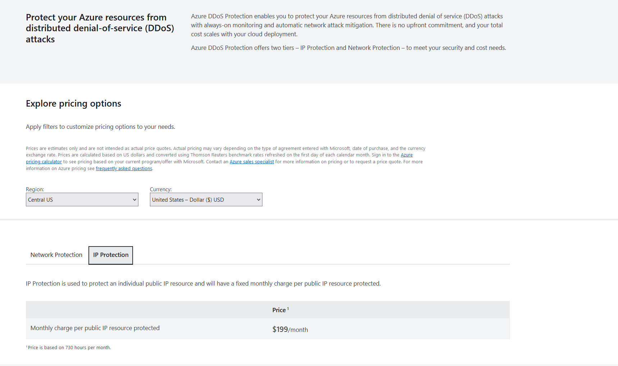
Effects of the DDoS attacks
Could not afford expensive DDoS Protection
Had to listen in to hacker’s demands.
Players got irritated with constant Connections issues.
Playerbase went down from an average of 120 players at peak time daily to
40, even 20 at times.
Notes:
Explain about high pricing.
2)We let him use hacks and cheats when everyone else was disallowed to.

Slide 16
Root-Causing

Slide 17
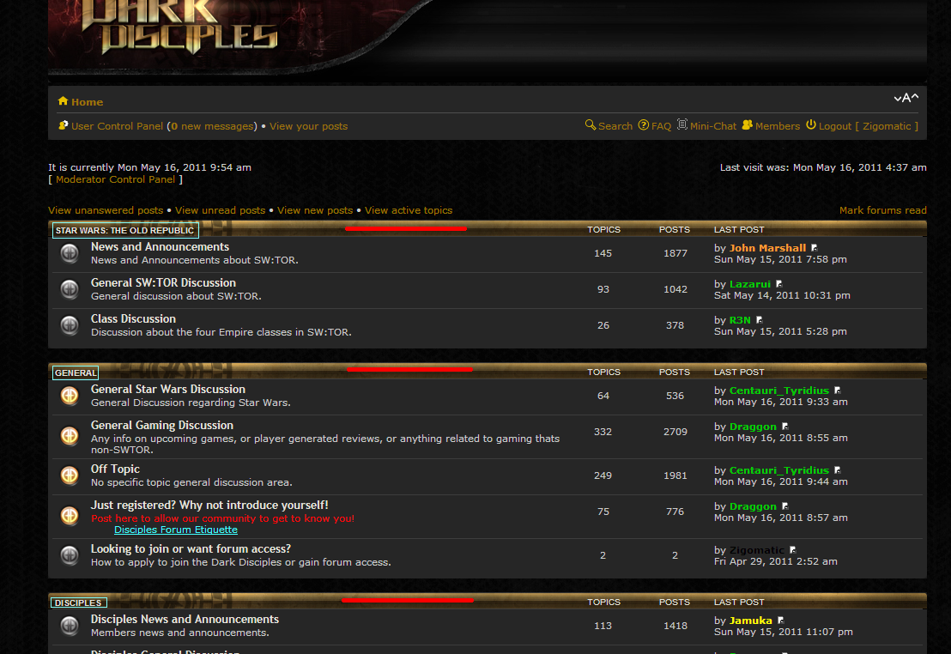
Finding Clues
TCP would have been safer, having less effect.
Finding Root Cause began now.
Game server, websites and forums all shared the same DNS name. Different providers.
During the attack, website and forums were slow but not down.
Websites/forums used TCP but with even minimal DDoS protection.
TS3 used same IP address as game-server but wasn’t affected.
Notes:
Explain how mitigating the attack took its priority that root-causing was left behind.
Tell how if TCP was used, this attack wouldn’t be so terrifying.| Explain in 3rd point with ‘surprising’ word.
Explain 4th point was the clue how you discovered the root-cause of attack.

Slide 18
(KINDA) SOLUTION TIME!
Port lead it to all!
192.168.1.1:10011 - TeamSpeak3 Port (TCP) (Required) (Open)
192.168.1.1:7777 - Game Server Port (UDP) (Required) (Open) (DDoS protected)
192.168.1.1:7778 - Game Server Port (UDP) (Not Required) (Open) !!!!
Attacks were directed at UDP ports, TCP was unaffected.
DDoS protection was offered at IP level & 7777 port by VPS providers, but no firewall was set from host to block traffic from other UDP ports.
DDoS attack utilized these non-existing firewall to attack on open UDP port with no traffic monitoring.

Slide 19
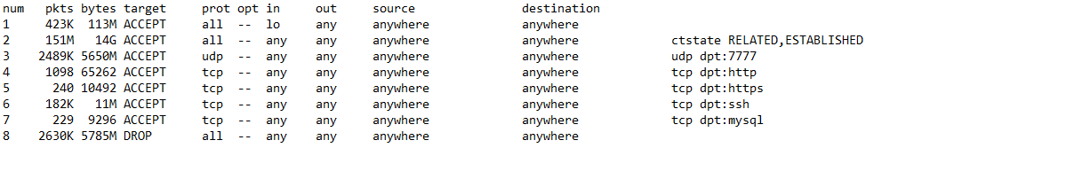
SOLUTION
Instead of selectively blocking traffic, implement a whitelist. Rule #1: Allow UDP traffic on port 7777
Rule #2: Drop any traffic on any port
Notes:
Ask host provider for whitelist Explain how the damage was already done, as the server lost most of its players

Slide 20
Thank you

